Slide 1

Ly Tu Trong College of Ho Chi Minh City
Bậc đào tạo: Cao Đẳng
Học phần: Anh Văn Chuyên ngành CNKT NHIỆT
Giảng viên: Nguyễn Thị Thanh Tú
Năm học: 2018 - 2019

Slide 2
Eric H. Glendinning
Norman Glendinning
Oxford English for Electrical and Mechanical Engineering

Slide 3
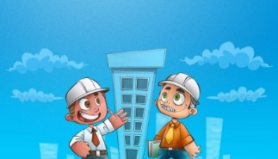
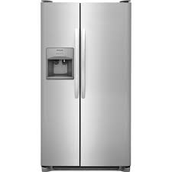
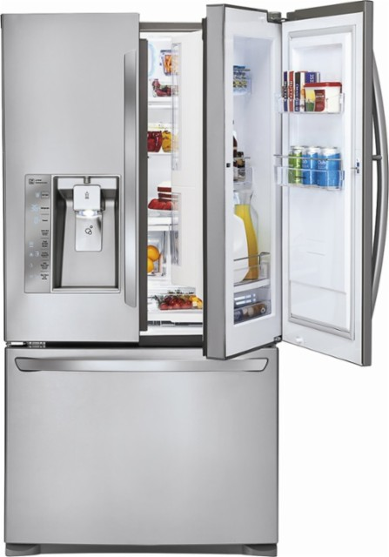
Unit 3 :
Refrigerator

Slide 4
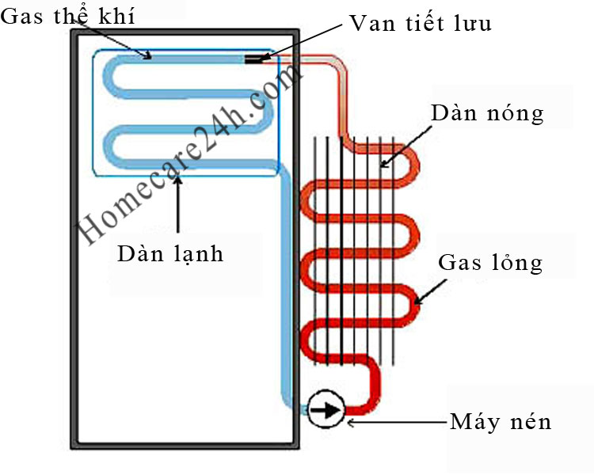
Task 1
The basic refrigerator has 4 main parts
Compresson ( máy nén )
Condenser ( dàn ngưng )
Capillary ( tiết lưu )
Evaporator ( thiết bị bay hơi )

Slide 5
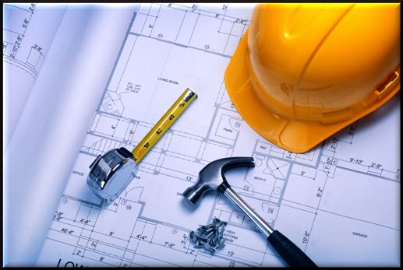
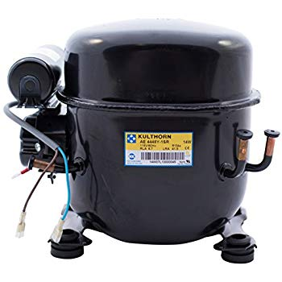
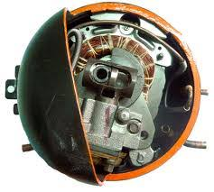
1. Compressor ( máy nén )

Slide 6
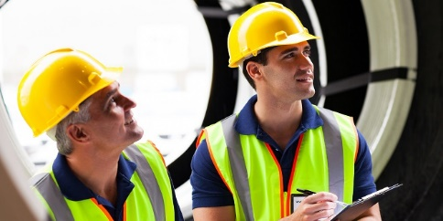
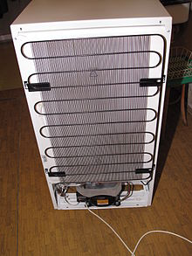
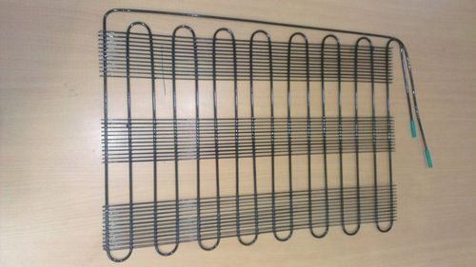
Condenser ( dàn ngưng )

Slide 7
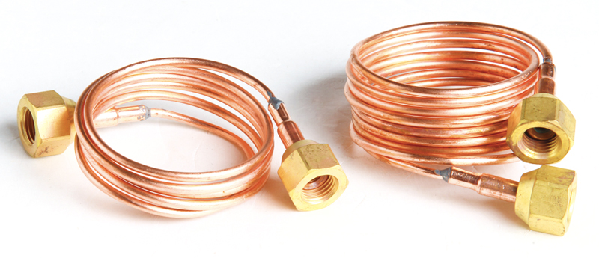
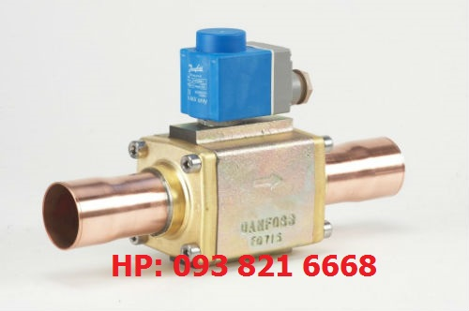
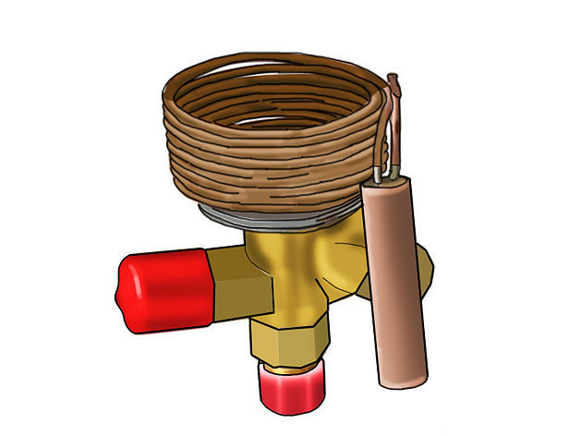
1. Capillary tube (ống tiết lưu )

Slide 8
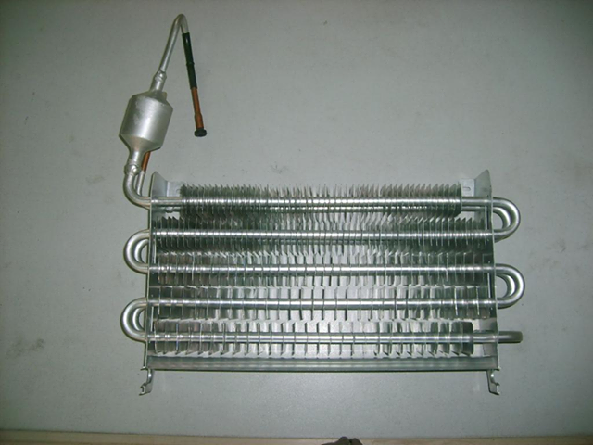
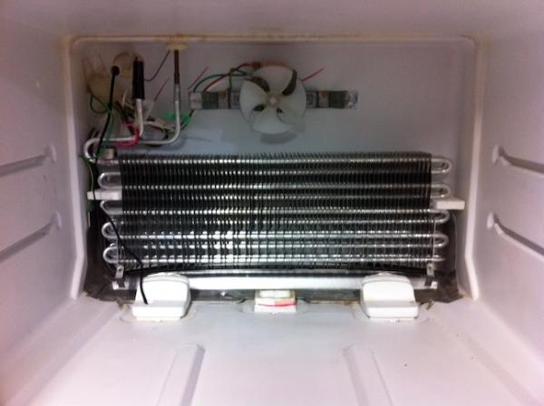
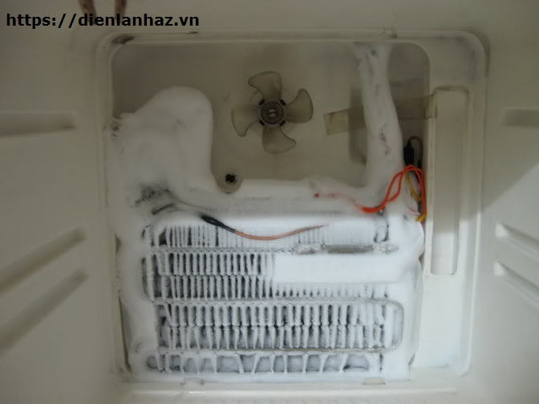
Evaporator ( thiết bị bay hơi )

Slide 9
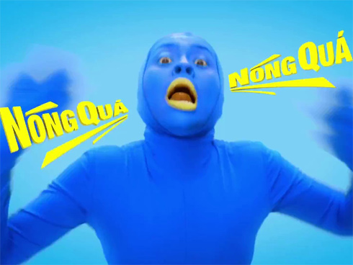
Task 2
Refrigeration preserves food by lowering its temperature. It slows down the growth and reproduction of micro-organisms such as bacteria and the action of enzymes which cause food to rot.

Slide 10
Refrigeration is based on three princiles. Firstly, if a liquid is heated, it changes to a gas or vapour. When this gas is cooled, it changes back into a liquid. secondly, if a gas is allowed to expand, it cools down. if a gas is compressed, it heats up. Thirdly, lowering the pressure around a liquid helps it to boil.

Slide 11
To keep the refrigerator at a constant low temperature, heat must be transferred from the inside of the cabinet to the outside. A refrigerant is used to do this. it is circulated around the fridge, where it undergoes changes in pressure and temperatunre and changes from a liquid to a gas and back again.

Slide 12
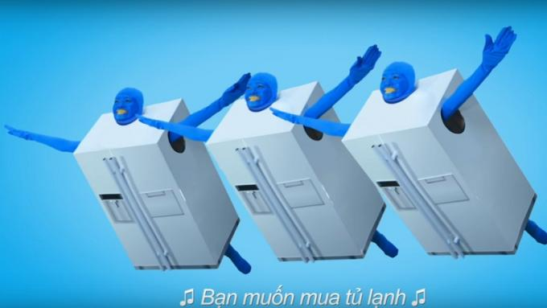
One common refrigerant is a compound of carbon, chlorine, and fluorine known as R12. This has a very low boiling point :-29˚C. At normal room temperature (about 20˚C) the liquid quickly turns into gas. However, newer refrigerants which are less harmful to the environment, such as KLEA 134A,are gradualy replacing R12.

Slide 13
The refrigeration process begins in the compressor. This compresses the gas that it heats up. It then pumps the gas into a condenser, a long tube in the shape of a zigzag. As the warm gas passes through the condenser, it heats the surroundings and cools down. By the time it leaves the condenser, it has condensed back into a liquid.

Slide 14
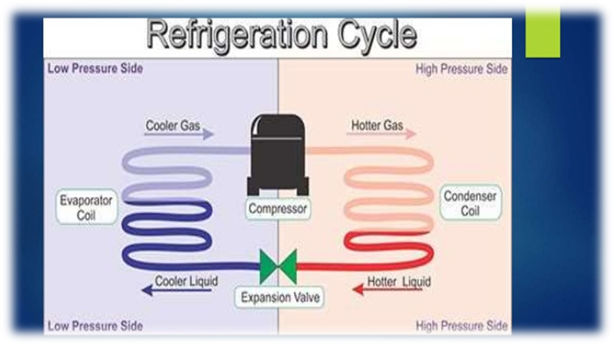
Liquid leaving the condenser has to flow down a very narrow tube s ta capillary tube). This prevents liquid from leaving the condenser too quickiy. and keeps it at a high pressure.

Slide 15
As the liquid passes from the narrow capillary tube to the larger tubes of the evaporator, the pressure quickly drops. The liquid turns to vapour, which expands and cools. The cold vapour absorbs heat from the fridge. It is then sucked back into the compressor and the process begins again.

Slide 16
Task 4: Word study
A.Verbs
Refrigerate
Condense
Compress
Resist
Generate
Conduct
Radiate
Control
B. Nouns
Refrigerator
Condenser
Compressor
resistor
5. Generator
6. Conductor
7. Radiator
8. controller

